Slide 1
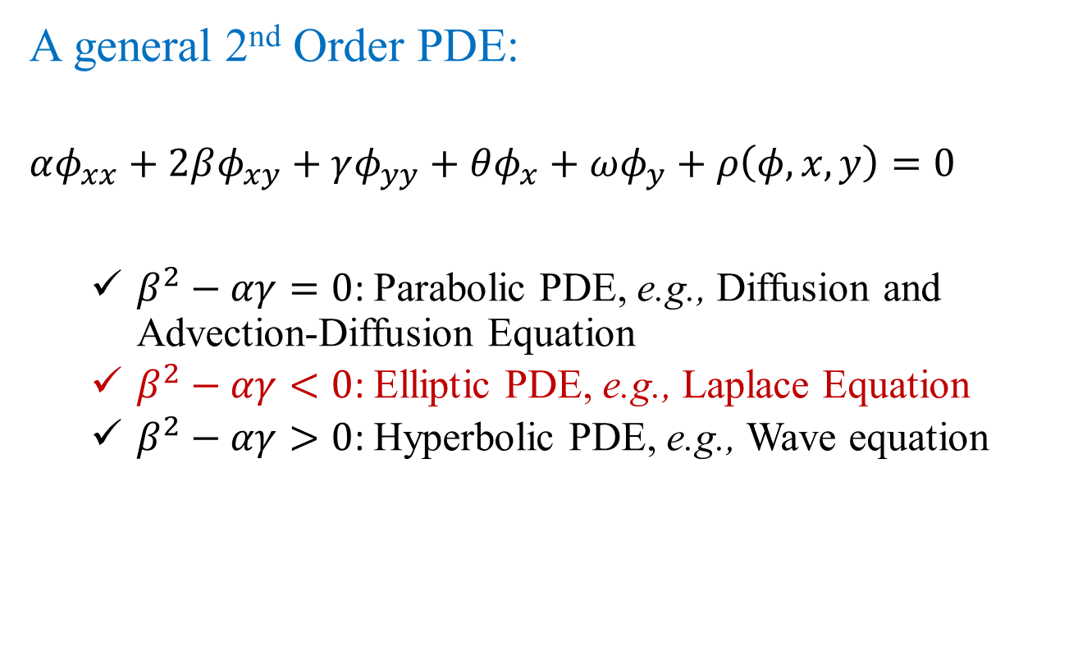
Introduction
A general 2nd Order PDE:
$$αφ_{xx}+2βφ_{xy}+γφ_{yy}+θφ_{x}+ωφ_{y}+ρ\left(φ,x,y\right)=0$$
$β^{2}−αγ=0$: Parabolic PDE, e.g., Diffusion and Advection-Diffusion Equation
$β^{2}−αγ<0$: Elliptic PDE, e.g., Laplace Equation
$β^{2}−αγ>0$: Hyperbolic PDE, e.g., Wave equation

Slide 2
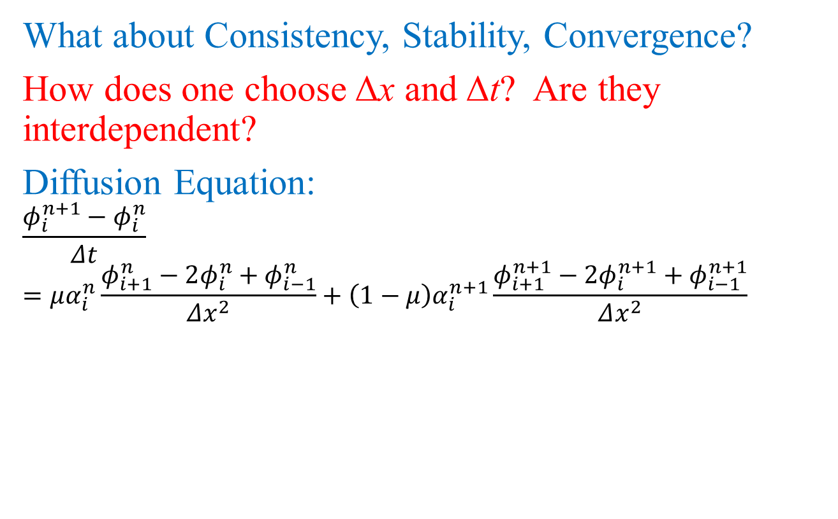

Convergence
What about Consistency, Stability, Convergence?
How does one choose Δx and Δt? Are they interdependent?
Diffusion Equation:
$$\frac{φ_{i}^{n+1}−φ_{i}^{n}}{Δt}=μα_{i}^{n}\frac{φ_{i+1}^{n}−2φ_{i}^{n}+φ_{i−1}^{n}}{Δx^{2}}+\left(1−μ\right)α_{i}^{n+1}\frac{φ_{i+1}^{n+1}−2φ_{i}^{n+1}+φ_{i−1}^{n+1}}{Δx^{2}}$$
Group $α\frac{∆t}{{∆x}^{2}}$ governs the equations.

Slide 3
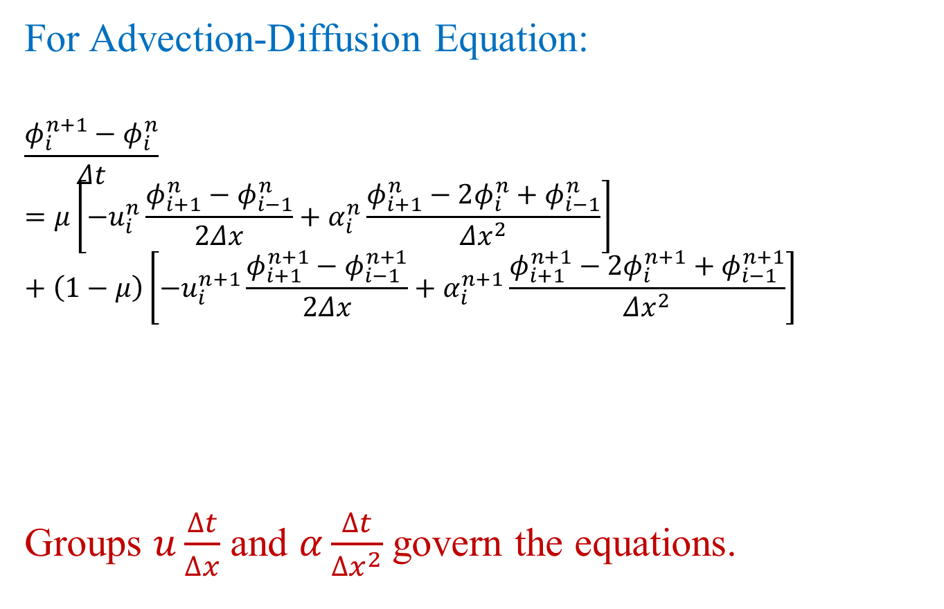
Convergence
For Advection-Diffusion Equation:
$$\frac{φ_{i}^{n+1}−φ_{i}^{n}}{Δt}=μ\left[−u_{i}^{n}\frac{φ_{i+1}^{n}−φ_{i−1}^{n}}{2Δx}+α_{i}^{n}\frac{φ_{i+1}^{n}−2φ_{i}^{n}+φ_{i−1}^{n}}{Δx^{2}}\right]+\left(1−μ\right)\left[−u_{i}^{n+1}\frac{φ_{i+1}^{n+1}−φ_{i−1}^{n+1}}{2Δx}+α_{i}^{n+1}\frac{φ_{i+1}^{n+1}−2φ_{i}^{n+1}+φ_{i−1}^{n+1}}{Δx^{2}}\right]$$
Groups $u\frac{∆t}{∆x}$ and $α\frac{∆t}{{∆x}^{2}}$ govern the equations.

Slide 4
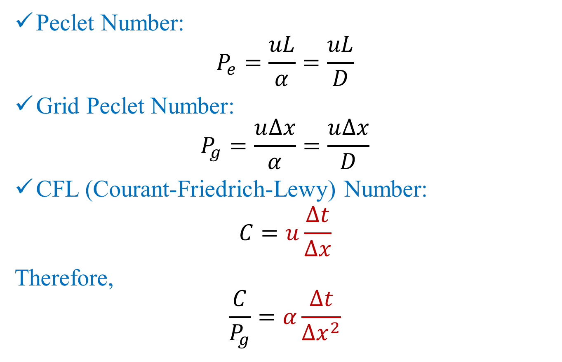
Convergence
Peclet Number:
$$P_{e}=\frac{uL}{α}=\frac{uL}{D}$$
Grid Peclet Number:
$$P_{g}=\frac{u∆x}{α}=\frac{u∆x}{D}$$
CFL (Courant-Friedrich-Lewy) Number:
$$C=u\frac{∆t}{∆x}$$
Therefore,
$$\frac{C}{P_{g}}=α\frac{∆t}{{∆x}^{2}}$$

Slide 5
Convergence
If u and 𝛼 are constants (not functions of x):
Then the solutions depend on these two dimensionless groups or numbers. Therefore, stability and convergence will also depend on these two!

Slide 6
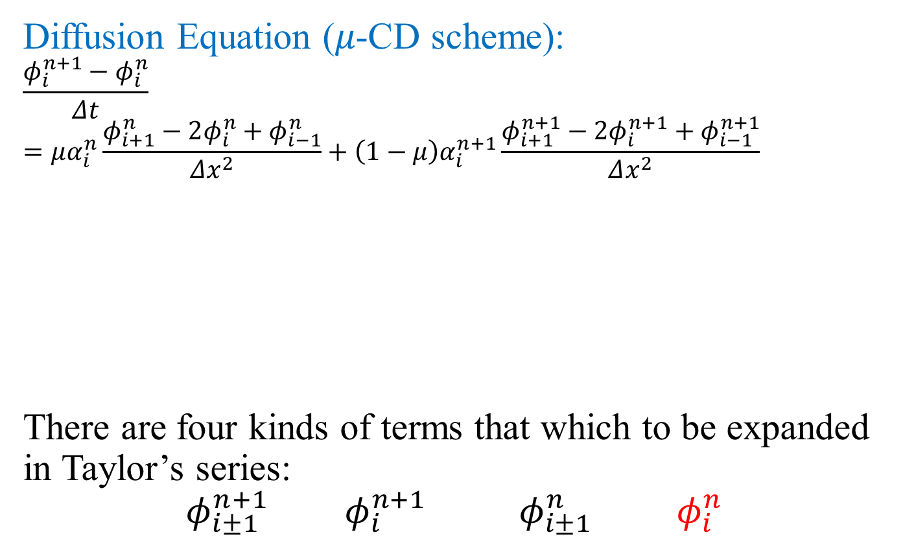
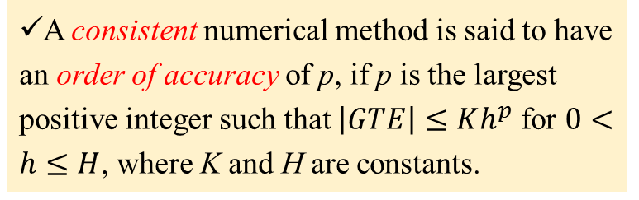
Consistency
A consistent numerical method is said to have an order of accuracy of p, if p is the largest positive integer such that $\left|GTE\right|≤Kh^{p}$ for $0<h≤H$, where K and H are constants.
Diffusion Equation (𝜇-CD scheme):
$$\frac{φ_{i}^{n+1}−φ_{i}^{n}}{Δt}=μα_{i}^{n}\frac{φ_{i+1}^{n}−2φ_{i}^{n}+φ_{i−1}^{n}}{Δx^{2}}+\left(1−μ\right)α_{i}^{n+1}\frac{φ_{i+1}^{n+1}−2φ_{i}^{n+1}+φ_{i−1}^{n+1}}{Δx^{2}}$$
There are four kinds of terms that which to be expanded in Taylor’s series:
$$φ_{i±1}^{n+1} φ_{i}^{n+1} φ_{i±1}^{n} φ_{i}^{n}$$

Slide 7
Consistency
…(1)

Slide 8
Expanding terms on both sides of equation (1) shown on the last slide

Slide 9
Consistency
Diffusion Equation (𝜇-CD scheme):
Truncation Error:

Slide 10
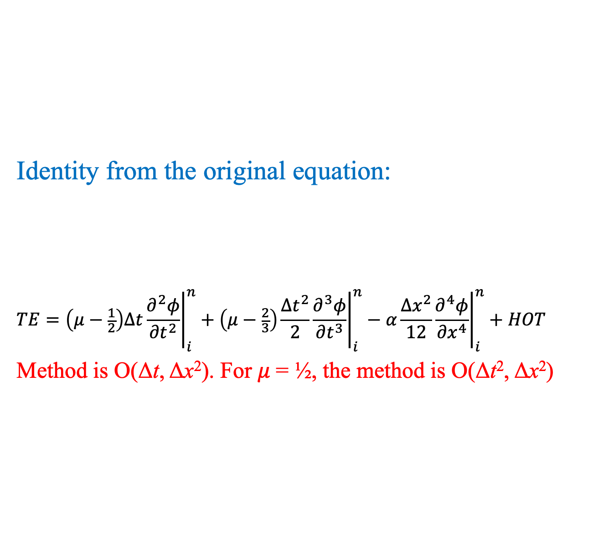
Consistency
Identity from the original equation:
$$TE=\left(μ−\frac{1}{2}\right)∆t{\left.\frac{∂^{2}φ}{{∂t}^{2}}\right|}_{i}^{n}+\left(μ−\frac{2}{3}\right)\frac{{∆t}^{2}}{2}{\left.\frac{∂^{3}φ}{{∂t}^{3}}\right|}_{i}^{n}−α\frac{{∆x}^{2}}{12}{\left.\frac{∂^{4}φ}{{∂x}^{4}}\right|}_{i}^{n}+HOT$$
Method is O(Δt, Δx²). For 𝜇 = ½, the method is O(Δt², Δx²)

Slide 11
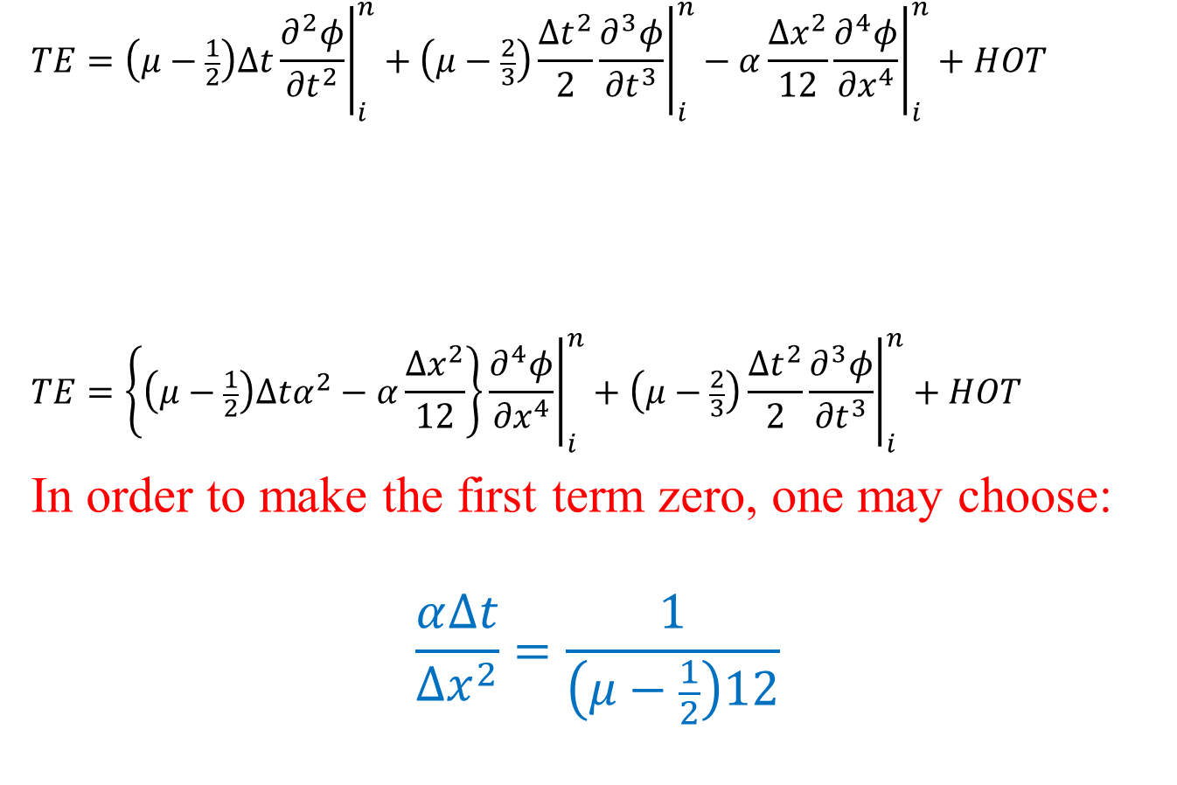
Consistency
$$TE=\left(μ−\frac{1}{2}\right)∆t{\left.\frac{∂^{2}φ}{{∂t}^{2}}\right|}_{i}^{n}+\left(μ−\frac{2}{3}\right)\frac{{∆t}^{2}}{2}{\left.\frac{∂^{3}φ}{{∂t}^{3}}\right|}_{i}^{n}−α\frac{{∆x}^{2}}{12}{\left.\frac{∂^{4}φ}{{∂x}^{4}}\right|}_{i}^{n}+HOT$$
$$TE=\left\{\left(μ−\frac{1}{2}\right)∆tα^{2}−α\frac{{∆x}^{2}}{12}\right\}{\left.\frac{∂^{4}φ}{{∂x}^{4}}\right|}_{i}^{n}+\left(μ−\frac{2}{3}\right)\frac{{∆t}^{2}}{2}{\left.\frac{∂^{3}φ}{{∂t}^{3}}\right|}_{i}^{n}+HOT$$
In order to make the first term zero, one may choose:
$$\frac{α∆t}{{∆x}^{2}}=\frac{1}{\left(μ−\frac{1}{2}\right)12}$$

Slide 12
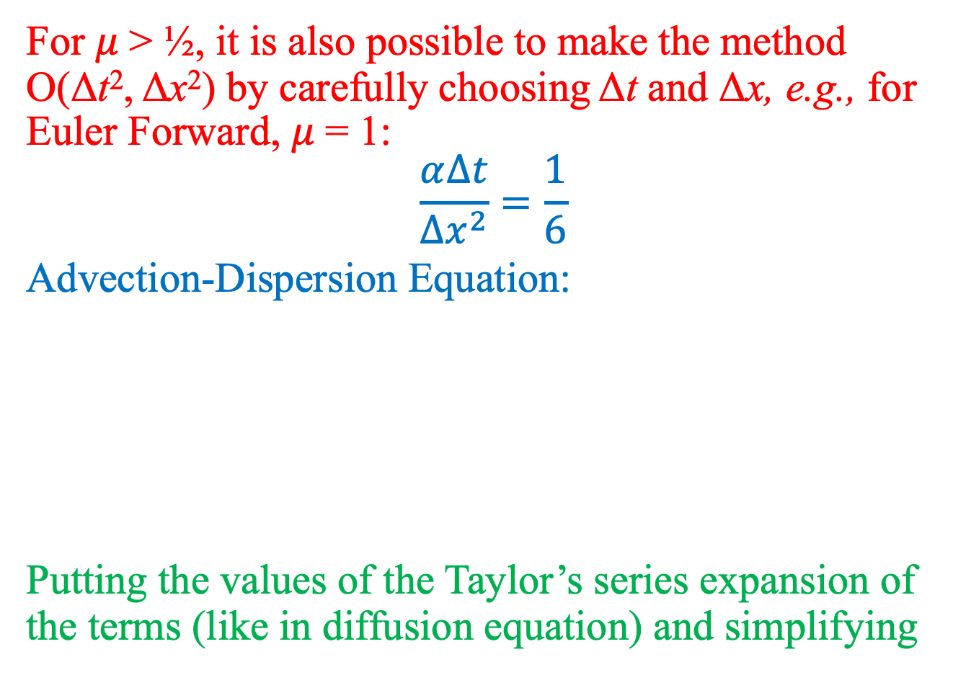
Consistency
For 𝜇 > ½, it is also possible to make the method O(Δt², Δx²) by carefully choosing Δt and Δx, e.g., for Euler Forward, 𝜇 = 1:
$$\frac{α∆t}{{∆x}^{2}}=\frac{1}{6}$$
Advection-Dispersion Equation:
Putting the values of the Taylor’s series expansion of the terms (like in diffusion equation) and simplifying

Slide 13
Consistency
No surprises in the order of accuracy! The method is O(Δt, Δx²). For 𝜇 = ½, the method is O(Δt², Δx²)
New surprise is:
Numerical Diffusion!

Slide 14
Consistency
Strategies to compensate for Numerical Diffusion:
Use modified Diffusion/Dispersion coefficient:
Use Backward difference approximation for the advection term
If you thought that combining schemes that are consistent independently will always give you a consistent scheme for PDE, think again!
Let us look at one scheme that combines two consistent schemes!

Slide 15
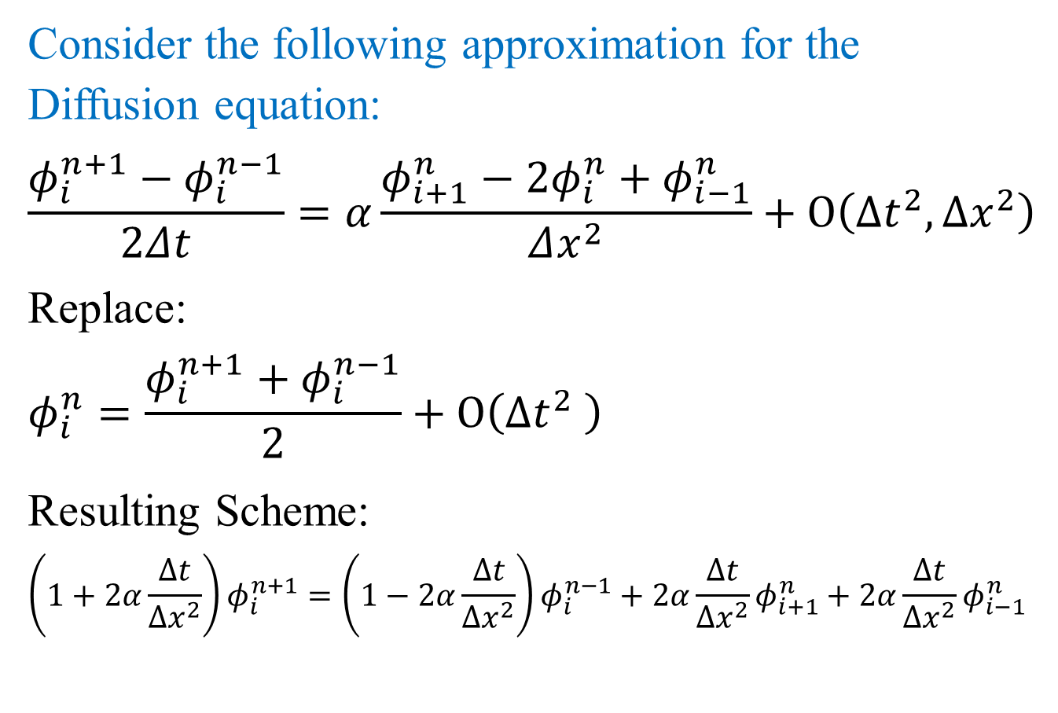
Consistency: inconsistent scheme
Consider the following approximation for the Diffusion equation:
$$\frac{φ_{i}^{n+1}−φ_{i}^{n−1}}{2Δt}=α\frac{φ_{i+1}^{n}−2φ_{i}^{n}+φ_{i−1}^{n}}{Δx^{2}}+O\left({∆t}^{2},{∆x}^{2}\right)$$
Replace:
$$φ_{i}^{n}=\frac{φ_{i}^{n+1}+φ_{i}^{n−1}}{2}+O\left({∆t}^{2} \right)$$
Resulting Scheme:
$$\left(1+2α\frac{∆t}{{∆x}^{2}}\right)φ_{i}^{n+1}=\left(1−2α\frac{∆t}{{∆x}^{2}}\right)φ_{i}^{n−1}+2α\frac{∆t}{{∆x}^{2}}φ_{i+1}^{n}+2α\frac{∆t}{{∆x}^{2}}φ_{i−1}^{n}$$

Slide 16
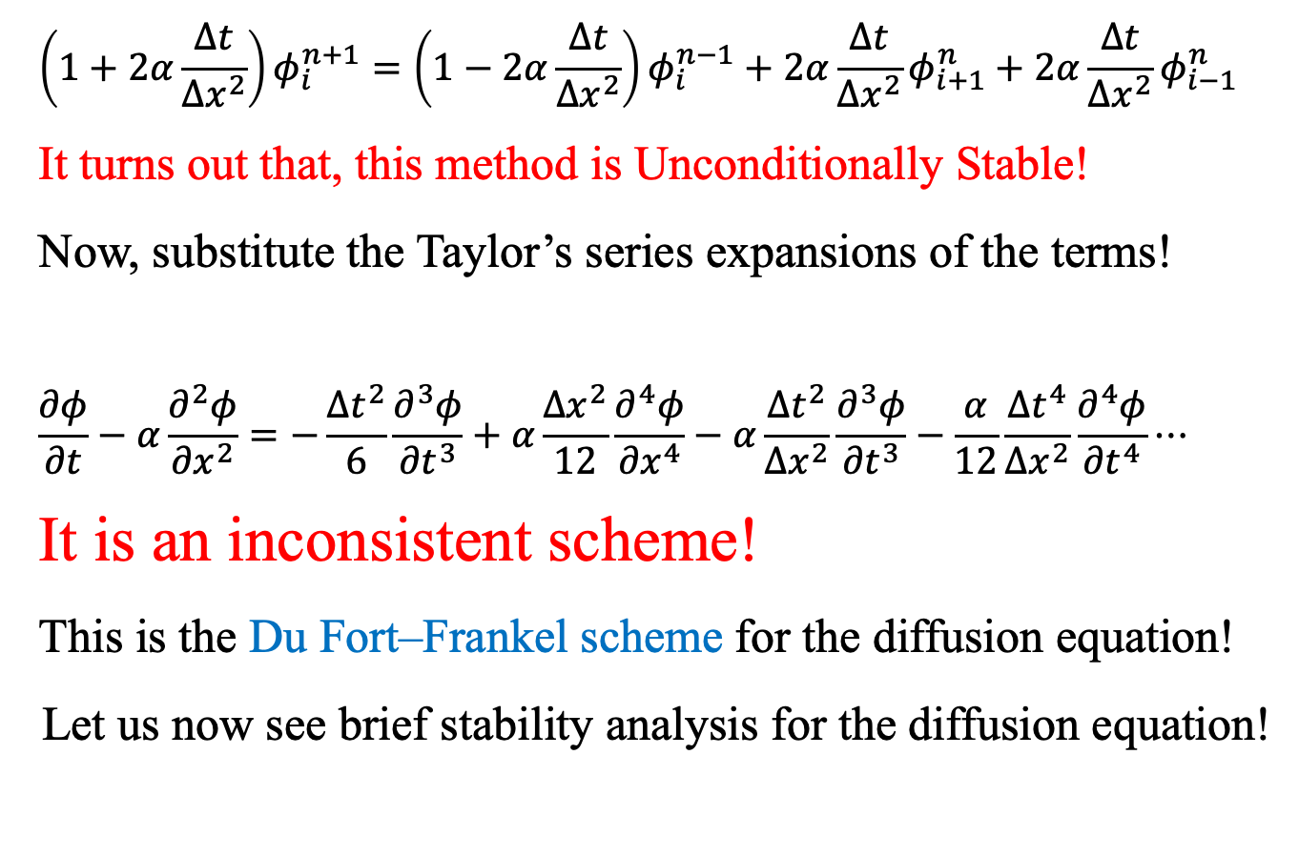
Consistency: inconsistent scheme
$$\left(1+2α\frac{∆t}{{∆x}^{2}}\right)φ_{i}^{n+1}=\left(1−2α\frac{∆t}{{∆x}^{2}}\right)φ_{i}^{n−1}+2α\frac{∆t}{{∆x}^{2}}φ_{i+1}^{n}+2α\frac{∆t}{{∆x}^{2}}φ_{i−1}^{n}$$
It turns out that, this method is Unconditionally Stable!
Now, substitute the Taylor’s series expansions of the terms!
$$\frac{∂φ}{∂t}−α\frac{∂^{2}φ}{{∂x}^{2}}=−\frac{{∆t}^{2}}{6}\frac{∂^{3}φ}{{∂t}^{3}}+α\frac{{∆x}^{2}}{12}\frac{∂^{4}φ}{{∂x}^{4}}−α\frac{{∆t}^{2}}{{∆x}^{2}}\frac{∂^{3}φ}{{∂t}^{3}}−\frac{α}{12}\frac{{∆t}^{4}}{{∆x}^{2}}\frac{∂^{4}φ}{{∂t}^{4}}⋯$$
It is an inconsistent scheme!
This is the Du Fort–Frankel scheme for the diffusion equation!
Let us now see brief stability analysis for the diffusion equation!

Slide 17
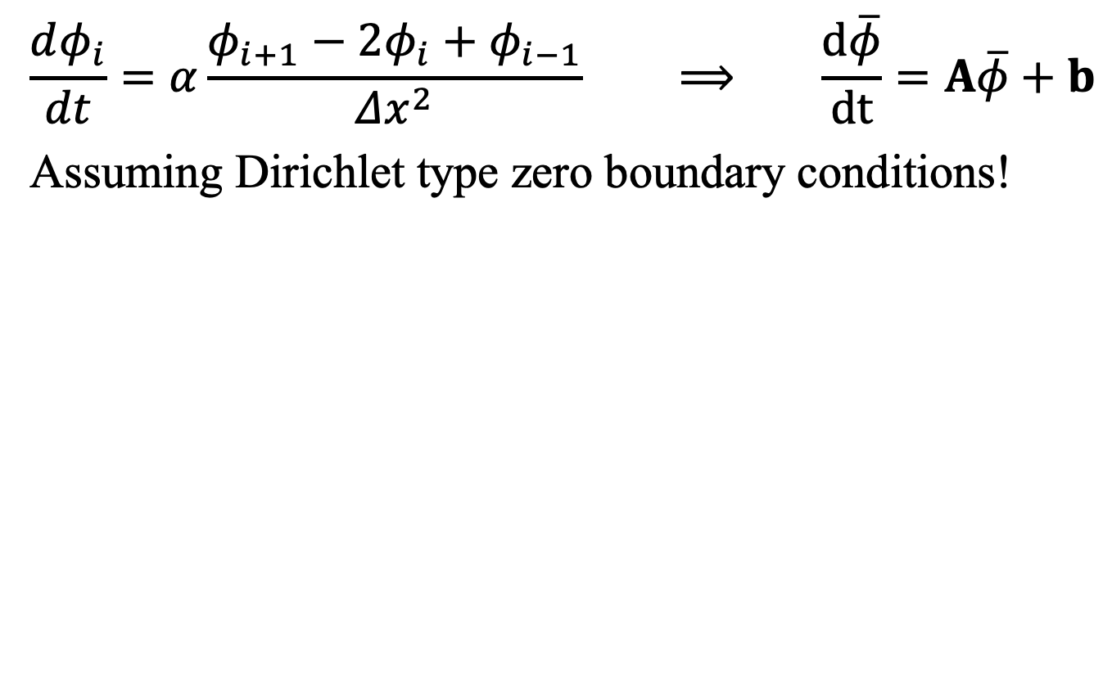
Stability: Diffusion Equation
$$\frac{dφ_{i}}{dt}=α\frac{φ_{i+1}−2φ_{i}+φ_{i−1}}{Δx^{2}} ⟹ \frac{d\overline{φ}}{dt}=A\overline{φ}+b$$
Assuming Dirichlet type zero boundary conditions!

Slide 18
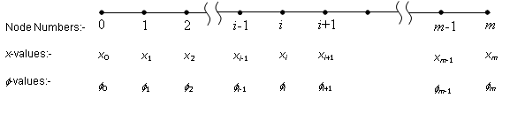
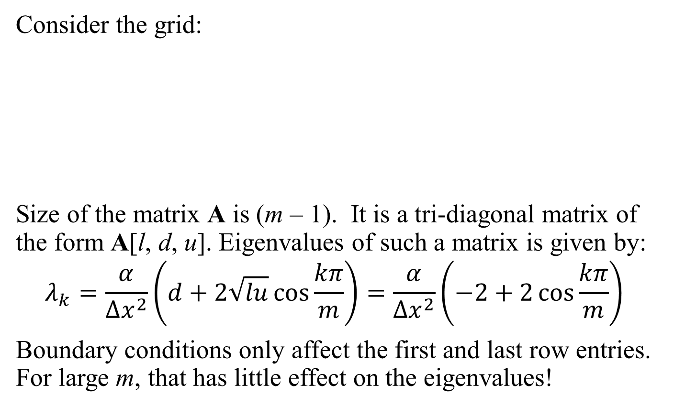
Stability: Diffusion Equation
Consider the grid:
Size of the matrix A is (m – 1). It is a tri-diagonal matrix of the form A[l, d, u]. Eigenvalues of such a matrix is given by:
$$λ_{k}=\frac{α}{{∆x}^{2}}\left(d+2\sqrt{lu}\cos{\frac{kπ}{m}}\right)=\frac{α}{{∆x}^{2}}\left(−2+2\cos{\frac{kπ}{m}}\right)$$
Boundary conditions only affect the first and last row entries. For large m, that has little effect on the eigenvalues!

Slide 19
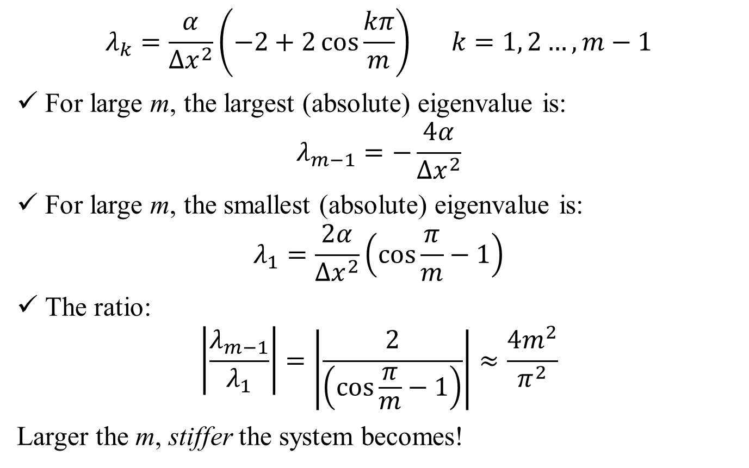
Stability: Diffusion Equation
$$λ_{k}=\frac{α}{{∆x}^{2}}\left(−2+2\cos{\frac{kπ}{m}}\right) k=1, 2…,m−1$$
For large m, the largest (absolute) eigenvalue is:
$$λ_{m−1}=−\frac{4α}{{∆x}^{2}}$$
For large m, the smallest (absolute) eigenvalue is:
$$λ_{1}=\frac{2α}{{∆x}^{2}}\left(\cos{\frac{π}{m}}−1\right)$$
The ratio:
$$\left|\frac{λ_{m−1}}{λ_{1}}\right|=\left|\frac{2}{\left(\cos{\frac{π}{m}}−1\right)}\right|≈\frac{4m^{2}}{π^{2}}$$
Larger the m, stiffer the system becomes!

Slide 20
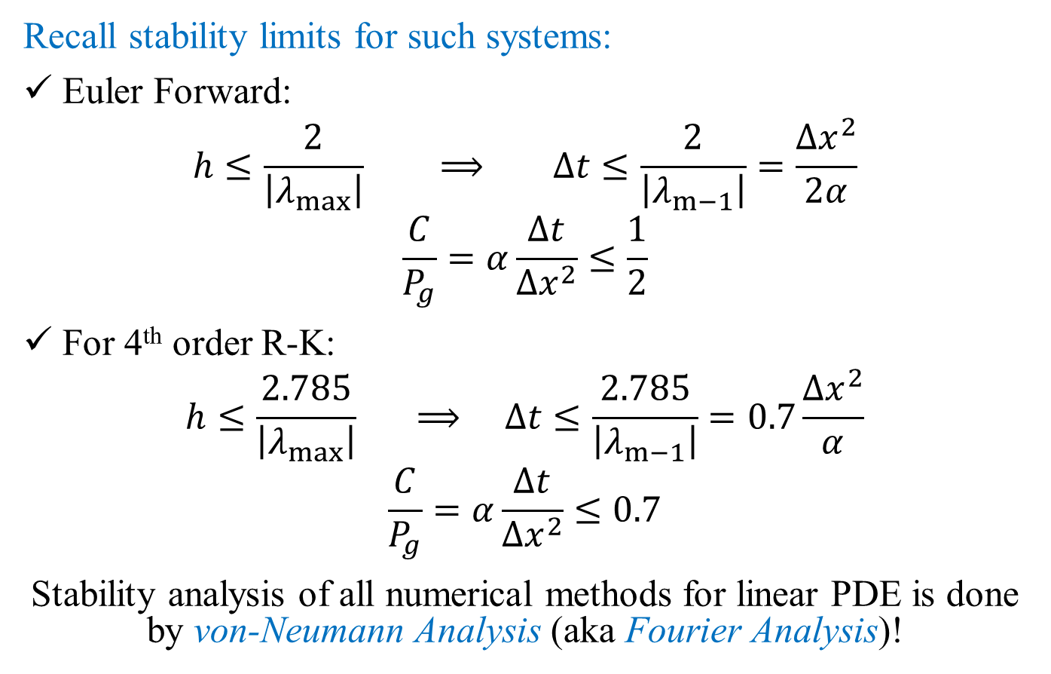
Stability: Diffusion Equation
Recall stability limits for such systems:
Euler Forward:
$$h≤\frac{2}{\left|λ_{max}\right|} ⟹ ∆t≤\frac{2}{\left|λ_{m−1}\right|}=\frac{{∆x}^{2}}{2α}$$
$$\frac{C}{P_{g}}=α\frac{∆t}{{∆x}^{2}}≤\frac{1}{2}$$
For 4th order R-K:
$$h≤\frac{2.785}{\left|λ_{max}\right|} ⟹ ∆t≤\frac{2.785}{\left|λ_{m−1}\right|}=0.7\frac{{∆x}^{2}}{α}$$
$$\frac{C}{P_{g}}=α\frac{∆t}{{∆x}^{2}}≤0.7$$
Stability analysis of all numerical methods for linear PDE is done by von-Neumann Analysis (aka Fourier Analysis)!

Slide 21
ESO 208A: Computational Methods in Engineering Partial Differential Equation: Elliptic Equation
Department of Civil Engineering
IIT Kanpur

Slide 22
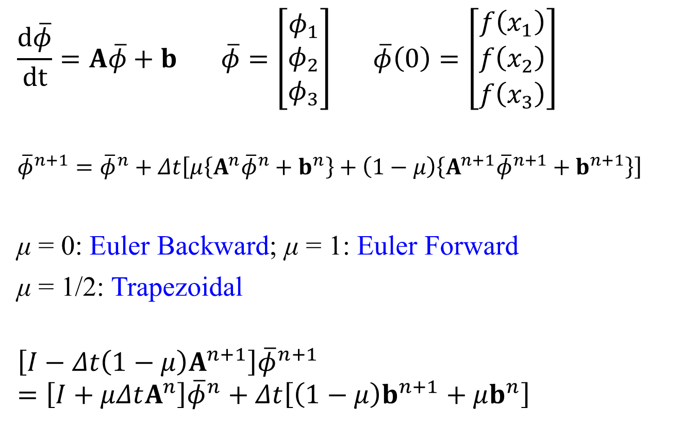
Laplace Equation: 1st Type BC
A
φ = a
B
1
2
3
4
Δx
5
6
7
8
φ = d
φ = b
$$∆x=\frac{L_{x}}{5}$$
9
10
11
12
$$∆y=\frac{L_{y}}{5}$$
13
14
15
16
y
Δy
D
x
C
φ = c

Slide 23
Laplace Equation
A
φ = a
B
1
2
3
4
Δx
5
6
7
8
φ = d
φ = b
9
10
11
12
13
14
15
16
Δy
D
φ = c
C
Create a node number vs. co-ordinate look-up table
Initialize a null matrix (A) of size N×N and a vector (b) of size N
N is the total number of unknown nodes.
Transform the equation to the form:
A𝜙 = b

Slide 24
Laplace Equation
A
φ = a
B
1
2
3
4
φ_{i,j-1}
Δx
5
6
7
8
φ = d
φ = b
9
10
11
12
φ_{i-1,j}
φ_{i,j}
φ_{i+1,j}
13
14
15
16
Δy
D
φ = c
C
φ_{i,j+1}

Slide 25
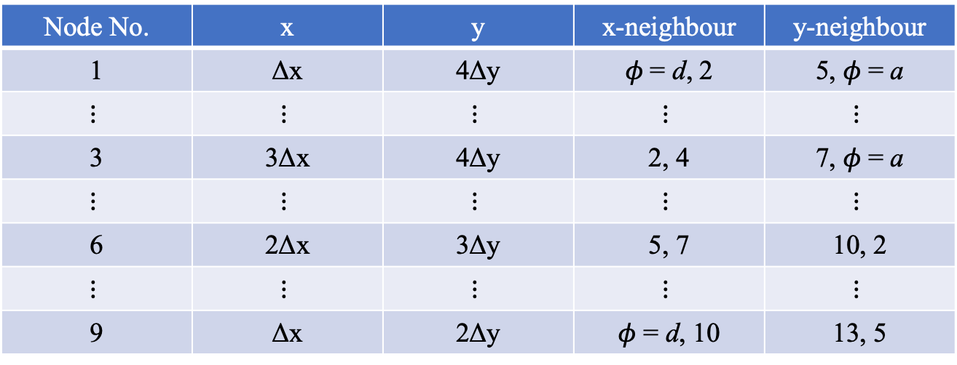
Laplace Equation
A
φ = a
B
1
2
3
4
Δx
5
6
7
8
Assuming the origin at D
φ = d
φ = b
9
10
11
12
13
14
15
16
Δy
D
φ = c
C
Node No. | x | y | x-neighbour | y-neighbour
1 | Δx | 4Δy | 𝜙 = d, 2 | 5, 𝜙 = a
$$⋮$$ | $$⋮$$ | $$⋮$$ | $$⋮$$ | $$⋮$$
3 | 3Δx | 4Δy | 2, 4 | 7, 𝜙 = a
$$⋮$$ | $$⋮$$ | $$⋮$$ | $$⋮$$ | $$⋮$$
6 | 2Δx | 3Δy | 5, 7 | 10, 2
$$⋮$$ | $$⋮$$ | $$⋮$$ | $$⋮$$ | $$⋮$$
9 | Δx | 2Δy | 𝜙 = d, 10 | 13, 5

Slide 26
𝜙
A
b
One equation for each node!

Slide 27
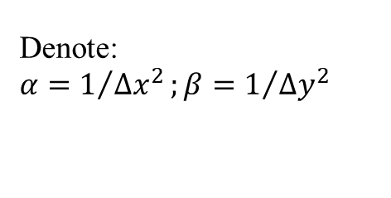
Laplace Equation
A
φ = a
B
φ_{i,j-1}
1
2
3
4
Δx
5
6
7
8
φ = d
φ = b
φ_{i-1,j}
φ_{i,j}
φ_{i+1,j}
9
10
11
12
13
14
15
16
Denote:
$$α=1/{{∆x}^{2}};β=1/{{∆y}^{2}}$$
Δy
φ_{i,j+1}
D
φ = c
C
a
Node 1
d
φ₁
φ₂
φ₅

Slide 28
Laplace Equation
A
φ = a
B
1
2
3
4
Δx
5
6
7
8
Assuming the origin at D
φ = d
φ = b
9
10
11
12
13
14
15
16
Δy
D
φ = c
C
Node No. | x | y | x-neighbour | y-neighbour
1 | Δx | 4Δy | 𝜙 = d, 2 | 5, 𝜙 = a
$$⋮$$ | $$⋮$$ | $$⋮$$ | $$⋮$$ | $$⋮$$
3 | 3Δx | 4Δy | 2, 4 | 7, 𝜙 = a
$$⋮$$ | $$⋮$$ | $$⋮$$ | $$⋮$$ | $$⋮$$
6 | 2Δx | 3Δy | 5, 7 | 10, 2
$$⋮$$ | $$⋮$$ | $$⋮$$ | $$⋮$$ | $$⋮$$
9 | Δx | 2Δy | 𝜙 = d, 10 | 13, 5

Slide 29
𝜙
A
b
One equation for each node!

Slide 30
Laplace Equation
A
φ = a
B
φ_{i,j-1}
1
2
3
4
Δx
5
6
7
8
φ = d
φ = b
φ_{i-1,j}
φ_{i,j}
φ_{i+1,j}
9
10
11
12
13
14
15
16
Denote:
$$α=1/{{∆x}^{2}};β=1/{{∆y}^{2}}$$
Δy
φ_{i,j+1}
D
φ = c
C
a
Node 3
φ₂
φ₃
φ₄
φ₇

Slide 31
Laplace Equation
A
φ = a
B
1
2
3
4
Δx
5
6
7
8
Assuming the origin at D
φ = d
φ = b
9
10
11
12
13
14
15
16
Δy
D
φ = c
C
Node No. | x | y | x-neighbour | y-neighbour
1 | Δx | 4Δy | 𝜙 = d, 2 | 5, 𝜙 = a
$$⋮$$ | $$⋮$$ | $$⋮$$ | $$⋮$$ | $$⋮$$
3 | 3Δx | 4Δy | 2, 4 | 7, 𝜙 = a
$$⋮$$ | $$⋮$$ | $$⋮$$ | $$⋮$$ | $$⋮$$
6 | 2Δx | 3Δy | 5, 7 | 10, 2
$$⋮$$ | $$⋮$$ | $$⋮$$ | $$⋮$$ | $$⋮$$
9 | Δx | 2Δy | 𝜙 = d, 10 | 13, 5

Slide 32
𝜙
A
b
One equation for each node!

Slide 33
Laplace Equation
A
φ = a
B
φ_{i,j-1}
1
2
3
4
Δx
5
6
7
8
φ = d
φ = b
φ_{i-1,j}
φ_{i,j}
φ_{i+1,j}
9
10
11
12
13
14
15
16
Denote:
$$α=1/{{∆x}^{2}};β=1/{{∆y}^{2}}$$
Δy
φ_{i,j+1}
D
φ = c
C
φ₂
Node 6
φ₅
φ₆
φ₇
φ₁₀

Slide 34
Laplace Equation
A
φ = a
B
1
2
3
4
Δx
5
6
7
8
Assuming the origin at D
φ = d
φ = b
9
10
11
12
13
14
15
16
Δy
D
φ = c
C
Node No. | x | y | x-neighbour | y-neighbour
1 | Δx | 4Δy | 𝜙 = d, 2 | 5, 𝜙 = a
$$⋮$$ | $$⋮$$ | $$⋮$$ | $$⋮$$ | $$⋮$$
3 | 3Δx | 4Δy | 2, 4 | 7, 𝜙 = a
$$⋮$$ | $$⋮$$ | $$⋮$$ | $$⋮$$ | $$⋮$$
6 | 2Δx | 3Δy | 5, 7 | 10, 2
$$⋮$$ | $$⋮$$ | $$⋮$$ | $$⋮$$ | $$⋮$$
9 | Δx | 2Δy | 𝜙 = d, 10 | 13, 5

Slide 35
𝜙
A
b
One equation for each node!

Slide 36
Laplace Equation
A
φ = a
B
φ_{i,j-1}
1
2
3
4
Δx
5
6
7
8
φ = d
φ = b
φ_{i-1,j}
φ_{i,j}
φ_{i+1,j}
9
10
11
12
13
14
15
16
Denote:
$$α=1/{{∆x}^{2}};β=1/{{∆y}^{2}}$$
Δy
φ_{i,j+1}
D
φ = c
C
φ₅
Node 9
d
φ₉
φ₁₀
φ₁₃

Slide 37
Laplace Equation
A
φ = a
B
1
2
3
4
Δx
5
6
7
8
Assuming the origin at D
φ = d
φ = b
9
10
11
12
13
14
15
16
Δy
D
φ = c
C
Node No. | x | y | x-neighbour | y-neighbour
1 | Δx | 4Δy | 𝜙 = d, 2 | 5, 𝜙 = a
$$⋮$$ | $$⋮$$ | $$⋮$$ | $$⋮$$ | $$⋮$$
3 | 3Δx | 4Δy | 2, 4 | 7, 𝜙 = a
$$⋮$$ | $$⋮$$ | $$⋮$$ | $$⋮$$ | $$⋮$$
6 | 2Δx | 3Δy | 5, 7 | 10, 2
$$⋮$$ | $$⋮$$ | $$⋮$$ | $$⋮$$ | $$⋮$$
9 | Δx | 2Δy | 𝜙 = d, 10 | 13, 5

Slide 38
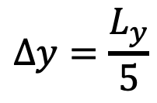
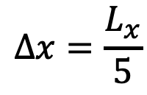
Laplace Equation: 1st and 2nd Type BC
A
φ = a
B
1
2
3
4
5
Δx
6
7
8
9
10
φ = d
$$∆x=\frac{L_{x}}{5}$$
$$∆y=\frac{L_{y}}{5}$$
11
12
13
14
15
16
17
18
19
20
Number of unknowns increased from 16 to 25
Δy
21
22
23
24
25
D
C

Slide 39
Neumann and Robin BC
Three Options for implementation:
Backward Difference approximation with increased size of the matrix
asymmetric backward difference approximation
size of the matrix is increased
solution at the boundary nodes are obtained together
Ghost Node
symmetric central difference approximation
size of the matrix is increased
solution at the boundary nodes are obtained together
Backward Difference approximation without increasing the size of the matrix
asymmetric backward difference approximation
size of the matrix remains unaltered
unknowns at the boundary nodes to be computed separately using the approximation of the BC after the solution have been computed for the interior nodes

Slide 40
Application of Backward Difference …approach 1
Number of equations is now 24 and the size of the matrix A is 24×24
For Node 5, the 5th equation is:
A
φ = a
B
For Node 21, the 21st equation is:
1
2
3
4
5
Δx
6
7
8
9
10
φ = d
11
12
13
14
15
16
17
18
19
20
Δy
21
22
23
24
25
D
C

Slide 41
Application of Backward Difference…approach 2
A
φ = a
B
1
2
3
4
4’
Δx
5
6
7
8
8’
Number of equations will remain at 16 and the size of the matrix A is 16×16
For Node 16, the 16th equation is:
φ = d
9
10
11
12
12’
13
14
15
16
16’
Δy
13’
14’
15’
16”
D
C

Slide 42
Application of Backward Difference…approach 2
A
φ = a
B
1
2
3
4
4’
Δx
5
6
7
8
8’
Number of equations will remain at 16 and the size of the matrix A is 16×16
For Node 16, the 16th equation is:
φ = d
9
10
11
12
12’
13
14
15
16
16’
Δy
13’
14’
15’
16”
D
C
Recall, for Node 16, the 16th equation for the 1st type BC was:

Slide 43
Application of Backward Difference…approach 2
A
φ = a
B
1
2
3
4
4’
Δx
5
6
7
8
8’
Number of equations will remain at 16 and the size of the matrix A is 16×16
For Node 8, the 8th equation is:
φ = d
9
10
11
12
12’
13
14
15
16
16’
Δy
13’
14’
15’
16”
D
C
’
’
’
After obtaining the solutions for the 16 interior nodes, the values of phi at the boundary nodes are to be computed from the BC equations used for substitution!

Slide 44
Ghost Node
Number of equations is now 25 and the size of the matrix A is 25×25
For Node 5:
For Node 23:
A
φ = a
B
1
2
3
4
5
5’
Δx
6
7
8
9
10
φ = d
11
12
13
14
15
16
17
18
19
20
Δy
25’
21
22
23
24
25
D
C
23’
25’’

Slide 45
Ghost Node
Number of equations is now 25 and the size of the matrix A is 25×25
For Node 25:
A
φ = a
B
1
2
3
4
5
5’
Δx
6
7
8
9
10
φ = d
11
12
13
14
15
16
17
18
19
20
Δy
25’
21
22
23
24
25
D
C
23’
25’’

Slide 46

ESO 208A: Computational Methods in Engineering Partial Differential Equation: Hyperbolic Equation
Department of Civil Engineering
IIT Kanpur

Slide 47
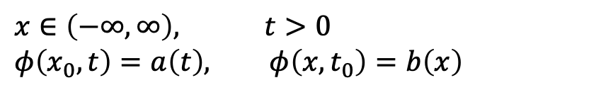
Wave Equation: 1st Order
$$x∈\left(−∞, ∞\right), t>0$$
$$φ\left(x_{0},t\right)=a\left(t\right), φ\left(x,t_{0}\right)=b\left(x\right)$$
𝜇-CD scheme:
If u is constant:

Slide 48
Consistency
$$x∈\left(−∞, ∞\right), t>0$$
$$φ\left(x_{0},t\right)=a\left(t\right), φ\left(x,t_{0}\right)=b\left(x\right)$$
For 𝜇 ≠ ½:
The method is O(Δt, Δx²)
Numerical Diffusion is present
For 𝜇 = ½:
The method is O(Δt², Δx²)
Numerical Diffusion is absent

Slide 49
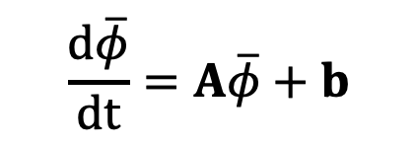
Stability
$$x∈\left(−∞, ∞\right), t>0$$
$$φ\left(x_{0},t\right)=a\left(t\right), φ\left(x,t_{0}\right)=b\left(x\right)$$
$$\frac{d\overline{φ}}{dt}=A\overline{φ}+b$$
For large m, largest eigenvalue (absolute) is:

Slide 50
Stability
All eigenvalues are imaginary!
Numerical time-stepping schemes, that are not stable for purely imaginary 𝜆, cannot be applied for this problem with central difference approximation for spatial derivative
Euler Forward (𝜇 = 1), multi-step methods up to 3rd order, 2nd Order Runge-Kutta method cannot be used
Euler Backward (𝜇 = 0), Trapezoidal method, all BDFs and 4th order Runge-Kutta can be used.
Some may have limitations on the time step, e.g., for 4th order R-K

Slide 51
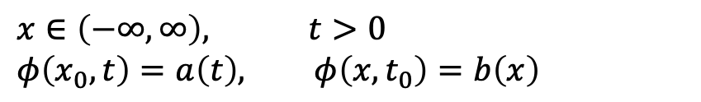
1st Order Wave Equation: Explicit Scheme
$$x∈\left(−∞, ∞\right), t>0$$
$$φ\left(x_{0},t\right)=a\left(t\right), φ\left(x,t_{0}\right)=b\left(x\right)$$
The problem of numerical diffusion and stability with Euler Forward can be addressed by simulating the numerical diffusion term (Lax-Wendorf Scheme):

Slide 52
1st Order Wave Equation: Upwind scheme
$$x∈\left(−∞, ∞\right), t>0$$
$$φ\left(x_{0},t\right)=a\left(t\right), φ\left(x,t_{0}\right)=b\left(x\right)$$
Performing TE analysis:
Numerical Diffusion is eliminated by choosing C = 1. The scheme is stable for

Slide 53
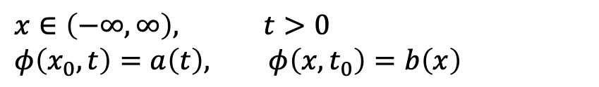
1st Order Wave Equation: Upwind scheme
$$x∈\left(−∞, ∞\right), t>0$$
$$φ\left(x_{0},t\right)=a\left(t\right), φ\left(x,t_{0}\right)=b\left(x\right)$$

Slide 54
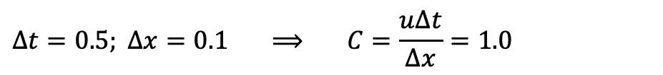
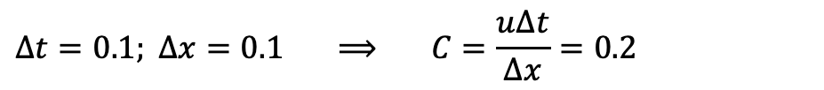
1st Order Wave Equation Example: Upwind scheme
$$∆t=0.1; ∆x=0.1 ⟹ C=\frac{u∆t}{∆x}=0.2$$
$$∆t=0.5; ∆x=0.1 ⟹ C=\frac{u∆t}{∆x}=1.0$$
Let us see the solutions!

Slide 55
Syllabus for End Sem
All topics covered in the course (40 lectures)
Roughly ~25% from pre-mid sem (could be part of post-mid sem problems or as exclusive problems)
Roughly ~75% from post-mid sem
Exceptions
Derivation involving local variables to derive cubic splines; numericals can be tested
Derivation of phase error in Stability problems of ODEs
Derivation of Du Fort–Frankel scheme

Slide 56
Consistent Attendance
Missed one class/ tutorial
100% attendance
170346 | KRISHAN KUMAR
170403 | MUDIT KUMAR
170410 | NAMAN AGRAWAL (M AGRAWAL)
170545 | RAKESH KUMAR
170632 | SARANSH NADDA
170739 | SUNIT SHARMA
180063 | AKSHAT KUMAR
180168 | AVIRAL AGGARWAL
180192 | BHARAT BHUSAN RATH
180360 | KORAPATI AKHIL RATNA
180658 | SAMPADA SINHA
180683 | SAURABH JAYANT
180749 | SHUBHAM GUPTA

Slide 57
Integrity
Voluntarily gave-up their marks which were incorrectly awarded to them
170660 | SHASHWAT SHUKLA
180182 | AYUSHI GOYAL
180404 | MANEESH P M
 | Another student whose record I did not keep

Slide 58
Acknowledgements
Tutors
Teaching Assistants
LHC Staff
Professors Saumyen Guha and Shivam Tripathi
Students who regularly put up with me ☹
Good luck in end-sems!
Please Use the Method Asked and Solve!

